Slide 1

ML Performance metrics for proxy
Apache Spot, November 1st, 2016
Prepared by: Gustavo A. Lujan

Slide 2
Proposed metrics recap

Slide 3
Evaluating LDA: supervised
Supervised: we have labeled data from artificially generated attacks (suspicious instances). We have to make the strong assumption that the rest of the data is non-suspicious. (It is impossible to label all the data).
Highly imbalanced data: An overwhelming majority of data corresponds to one class (non-suspicious) and a very small portion corresponds to anomalies (suspicious).

Slide 4
Evaluating LDA: supervised
Accuracy =(TP+TN)/(TP+FN+FP+TN). Highly discouraged due to imbalanced data.
Error rate = 1- accuracy. Highly discouraged for the same reason.
TPrate = TP/(TP+FN) = power = sensitivity = recall. Suggested metric.
TNrate = TN/(FP+TN) = specificity. Suggested metric.
Confusion matrix
Definitions:
S: Suspicious class
NS: Non-suspicious class
TP: True positive
FN: False negative
FP: False positive
TN: True negative
 |  | Predicted
 |  | + S | - NS
Actual | + S | TP | FN
 | - NS | FP | TN

Slide 5
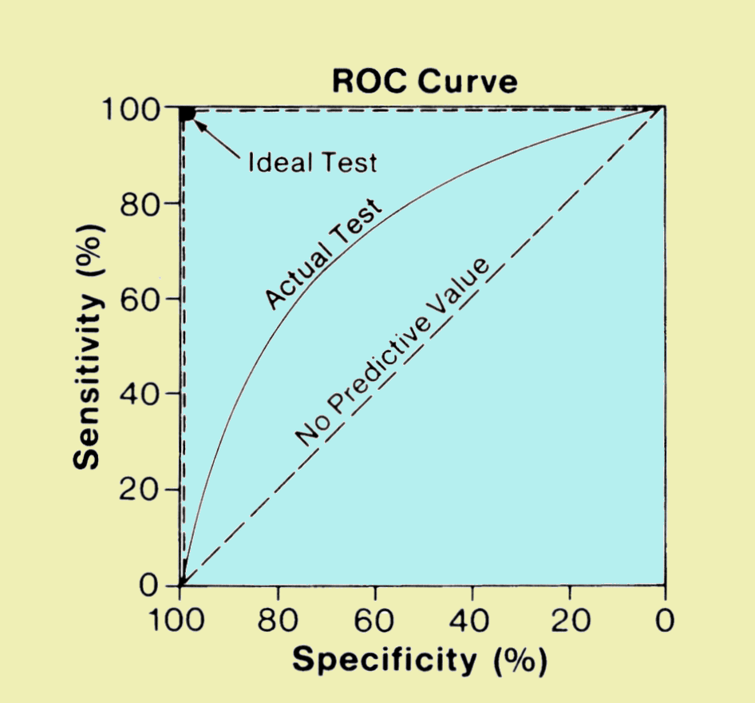
Evaluating LDA: supervised
Another more powerful approach would be that of the Receiving Operating Characteristic (ROC) curve.
The ROC curve illustrates the performance of a binary classifier as the discrimination threshold is varied.
In LDA we have to define a threshold. The ROC will show the performance of the model regardless of the threshold we select.

Slide 6
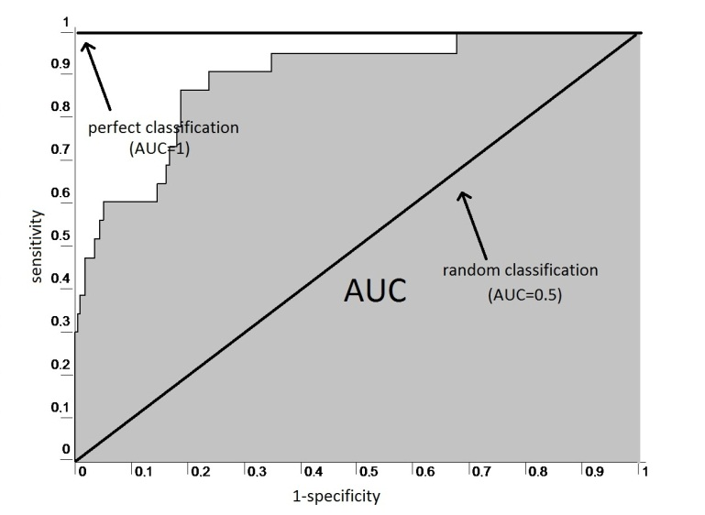
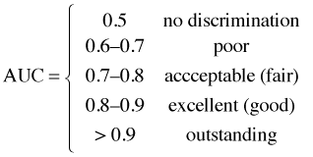
Evaluating LDA: supervised
A performance metric directly related to the ROC curve is the area under the curve (AUC).
Values close to 1 reflect good performance while values close to 0.5 mean that the model is no better than random chance.
A good characteristic of the AUC is that it is independent of the proportion of the classes. This makes it useful for unbalanced data sets.

Slide 7
Computing AUC in an efficient way
LDA provides a score. The scores can be ordered. Once ordered we have the rank of each instance.
If we know the ranks of the positive class (suspicious) which is the minority class (N1) then we know the rank of the negative class (N2>>N1). Sensitivity and specificity can now be computed.
We only need the rank of the N1 instances. AUC is computed summing the area of the rectangles.
Sensitivity will only change N1 times in the ROC. Specificity will decrease linearly N2 times

Slide 8
Datasets used for Proxy
“Normal” dataset
9,067,164 total number of records corresponding to y=2015, m=03 and d=01.
The assumption is that all this data is “normal” (might not be true)
“Abnormal” dataset
105 total number of unique attacks (not replicated)
EK_MALWARE malspam-amil
BIN_DNSWATCH
BIN_Mediana
RTF Mongall Dropper
APT ZEUS
Cryptolocker ….. And others

Slide 9
Results

Slide 10
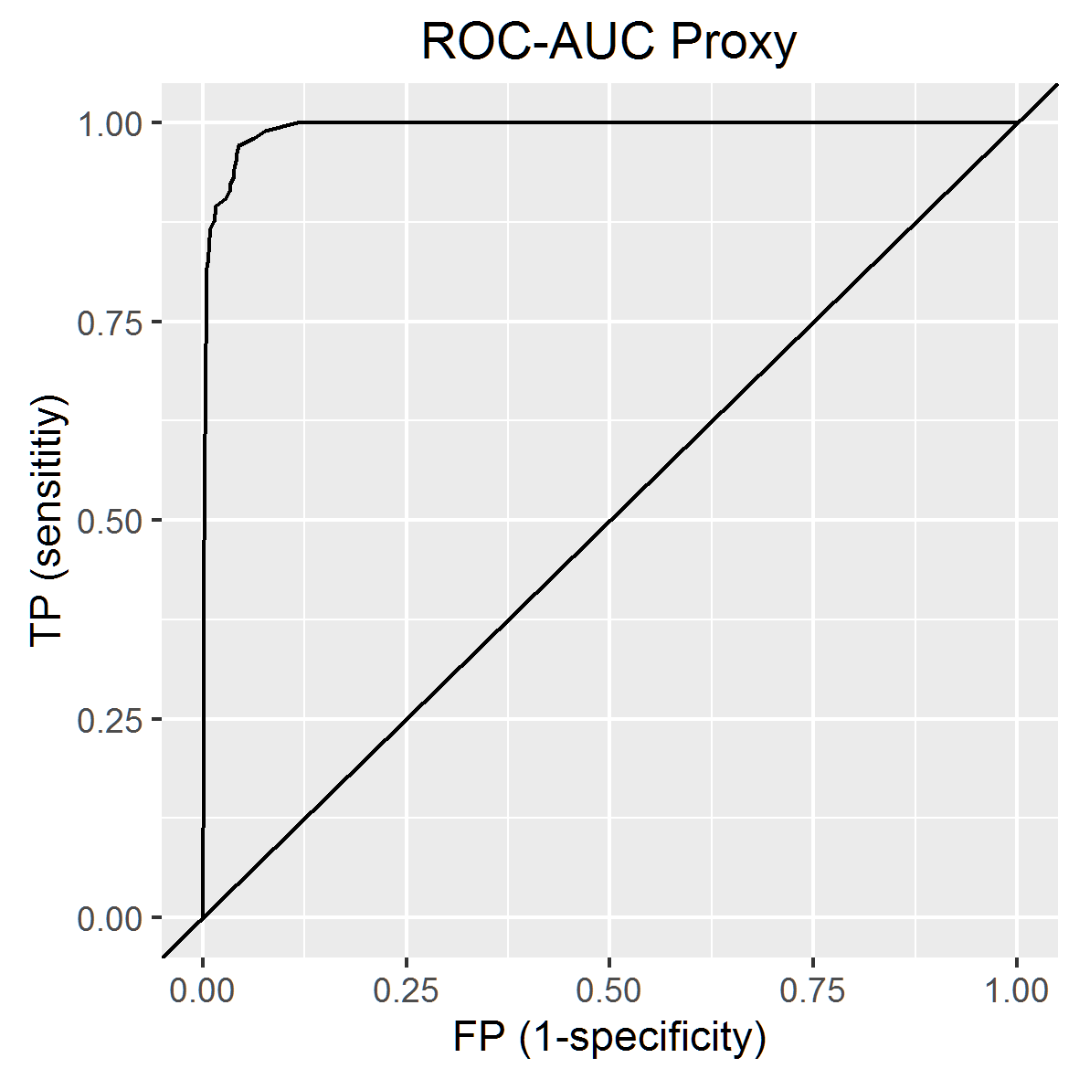
Results
From a theoretical point of view LDA provides an impressive performance in terms of ROC-AUC = 0.9923
This means that regardless of the threshold chosen it provides overall good balance of TP and FP.
From a practical point of view the massive amount of “good” data still makes the security analyst go through a lot of false positives. (or maybe not, remember we are assuming that attacks not generated by us are “good”)
AUC = 0.9933

Slide 11
Results (the amount of chaff)
host | score | rank | label | ID | TP | FP
0 | 0 | 0 | null | 0 | 0 | 0
vcvcvcvc.dyndns.org | 4.44E-07 | 89 | bad | 1 | 0.009524 | 9.48E-06
vcvcvcvc.dyndns.org | 4.44E-07 | 90 | bad | 2 | 0.019048 | 9.48E-06
vcvcvcvc.dyndns.org | 4.44E-07 | 91 | bad | 3 | 0.028571 | 9.48E-06
www.dnswatch.info | 4.58E-07 | 98 | bad | 4 | 0.038095 | 1.01E-05
trapbath.ru | 7.68E-07 | 551 | bad | 5 | 0.047619 | 6.00E-05
trapbath.ru | 7.68E-07 | 552 | bad | 6 | 0.057143 | 6.00E-05
trapbath.ru | 1.29E-06 | 2241 | bad | 7 | 0.066667 | 0.000246
trapbath.ru | 1.29E-06 | 2242 | bad | 8 | 0.07619 | 0.000246
trapbath.ru | 1.54E-06 | 3142 | bad | 9 | 0.085714 | 0.000345
trapbath.ru | 1.54E-06 | 3143 | bad | 10 | 0.095238 | 0.000345
61.178.77.169 | 2.12E-06 | 5661 | bad | 11 | 0.104762 | 0.000623
61.178.77.170 | 2.12E-06 | 5662 | bad | 12 | 0.114286 | 0.000623
61.178.77.169 | 2.41E-06 | 6790 | bad | 13 | 0.12381 | 0.000747
146.185.213.35 | 2.47E-06 | 7007 | bad | 14 | 0.133333 | 0.000771
vcvcvcvc.dyndns.org | 3.15E-06 | 9790 | bad | 15 | 0.142857 | 0.001078
….. | …. | …. | …. | …. | …. | ….
The amount of “chaff” can be seen in the following table.
By looking at the rank of the “bad” instances we know what threshold we are willing to accept and the TP and FP associated with it.
For example, if our threshold is 2242 then we will find 8 “bad” instances and 2242-8 = 2234 “good” instances.
The table is truncated. TP and FP columns are the ones used to plot ROC.

Slide 12
Results (types of attacks)
rank | id | Type of attack
89 | 1 | BIN_DNSWATCH
90 | 2 | BIN_DNSWATCH
91 | 3 | BIN_DNSWATCH
98 | 4 | BIN_DNSWATCH
551 | 5 | APT ZEUS
552 | 6 | APT ZEUS
2241 | 7 | APT ZEUS
2242 | 8 | APT ZEUS
3142 | 9 | APT ZEUS
3143 | 10 | APT ZEUS
… | … | …
296185 | 96 | BIN_Mediana
307252 | 97 | BIN_Mediana
348334 | 98 | No name
349569 | 99 | APT ZEUS
366444 | 100 | No name
374053 | 101 | APT ZEUS
394876 | 102 | BIN_Mediana
573898 | 103 | BIN_Mediana
693769 | 104 | BIN_Mediana
1053390 | 105 | BIN_Mediana
BIN_DNSWATCH was the type of attack with the lowest rank (89-98), easiest to detect.
APT ZEUS was the second lowest ranked type of attack (551-3143).
At the bottom of the list we have again some types of APT ZEUS attacks that were difficult to identify (349569, 374053).
At the bottom we have BIN_Mediana as the type of attack most difficult to detect in this specific dataset.
The table is truncated. A separate file is provided with all the attacks.

Slide 13
Next steps
Create a repository of attacks we can re-use.
Repeat procedure using other normal dataset (other day worth of data).
Repeat procedure for Netflow and DNS.
Discuss with team additional performance metrics. (See next slide).
Tune LDA or create new features to improve this performance.

Slide 14
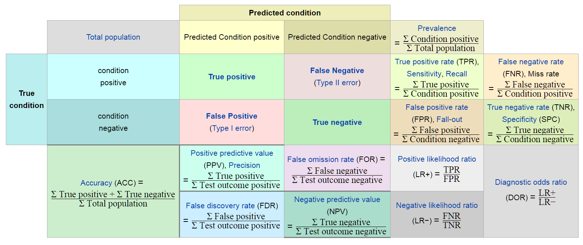
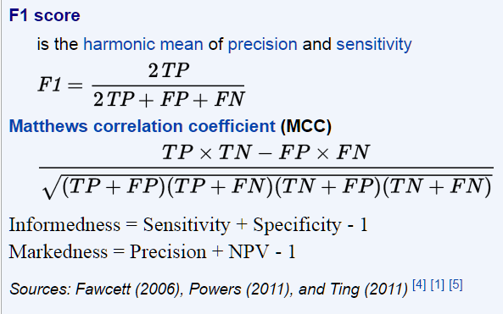
Additional performance metrics
https://en.wikipedia.org/wiki/Precision_and_recall

